Slide 1


Computer Vision
Plant Disease Detection
Maheen Sadaf
F2021376104

Slide 2


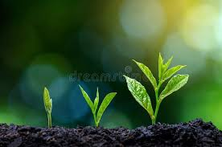
Project Phases
Tuning of the model
Project Proposal
Presentation
Initial Model Development

Slide 3
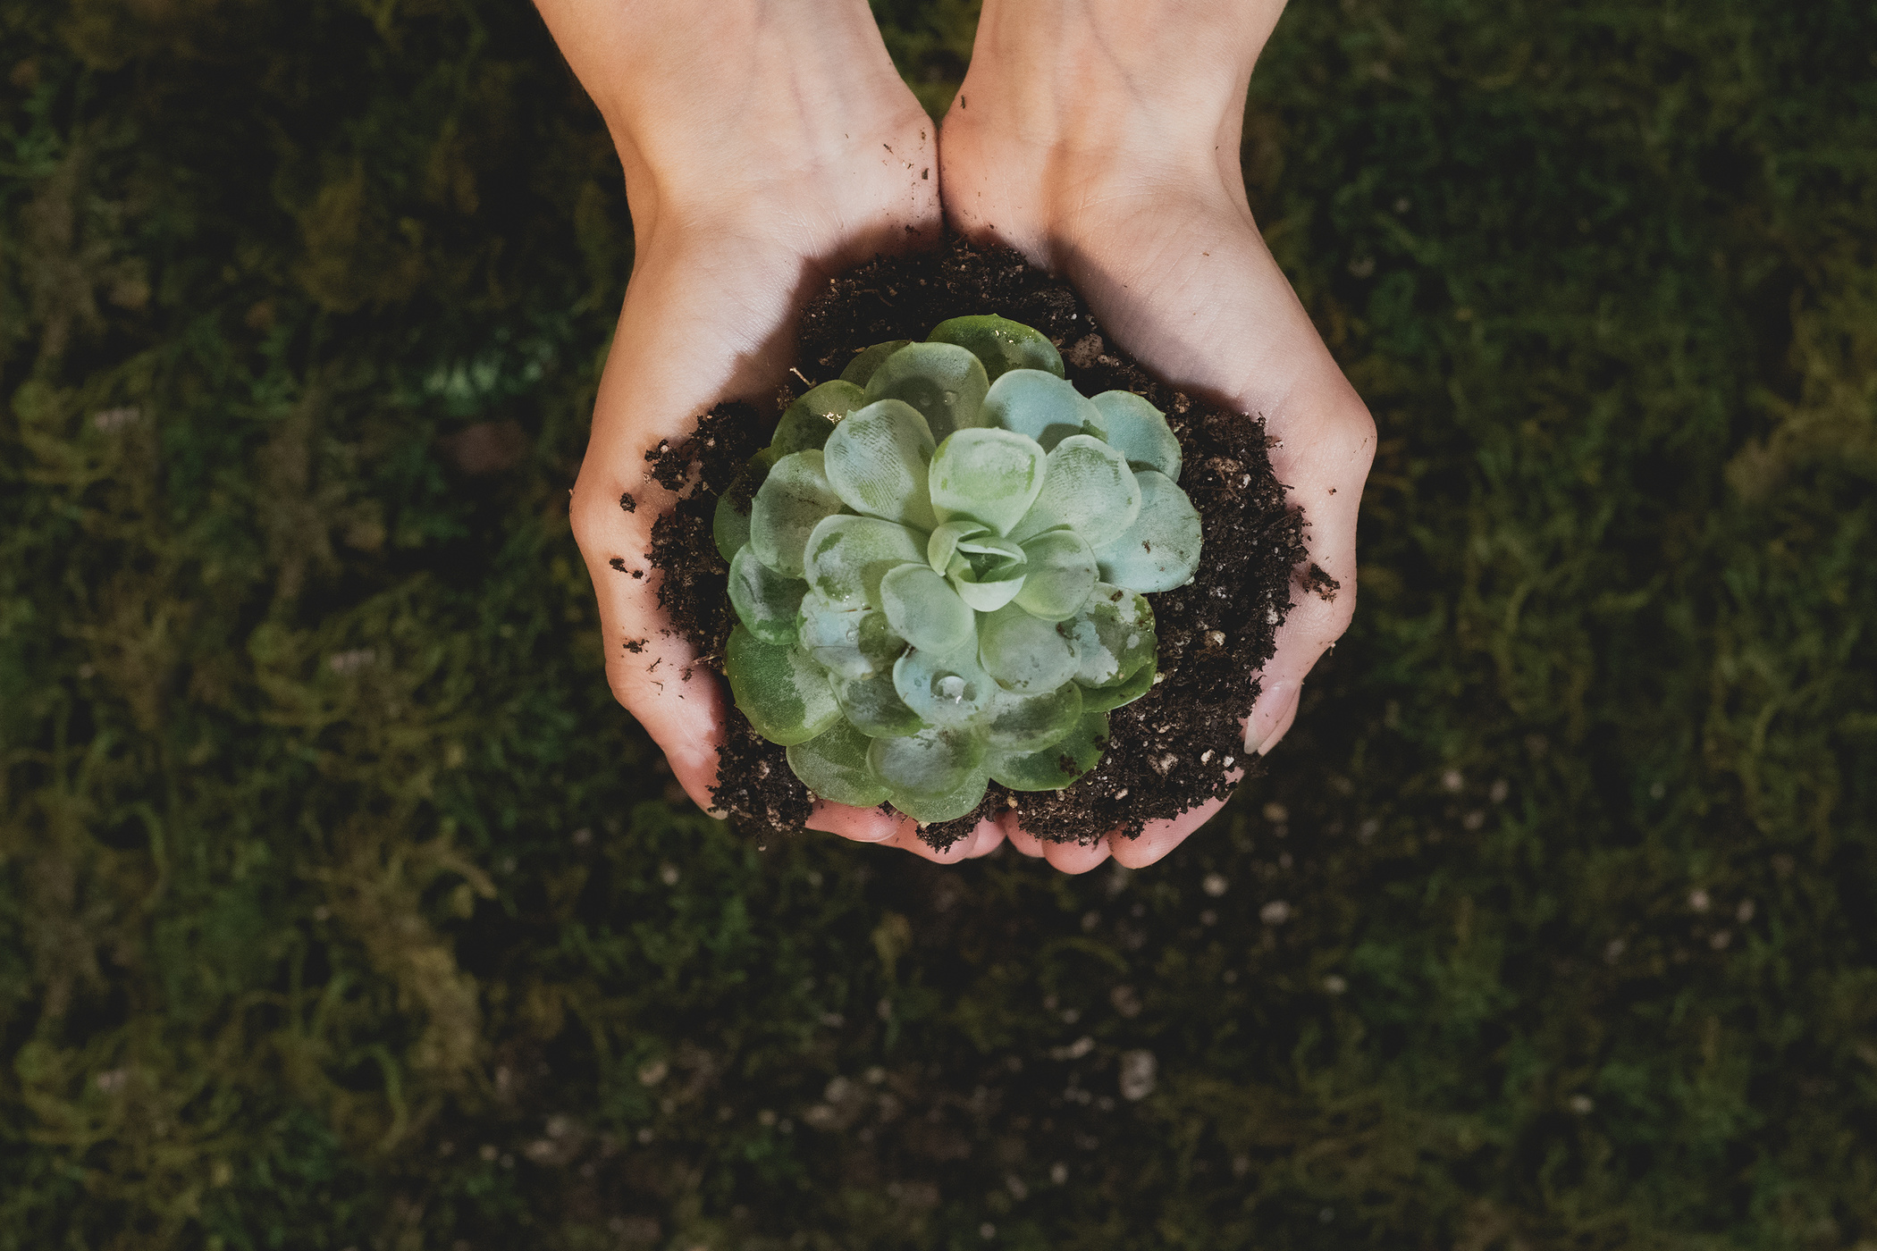
Introduction
Overview of the project
Goals of the project

Slide 4
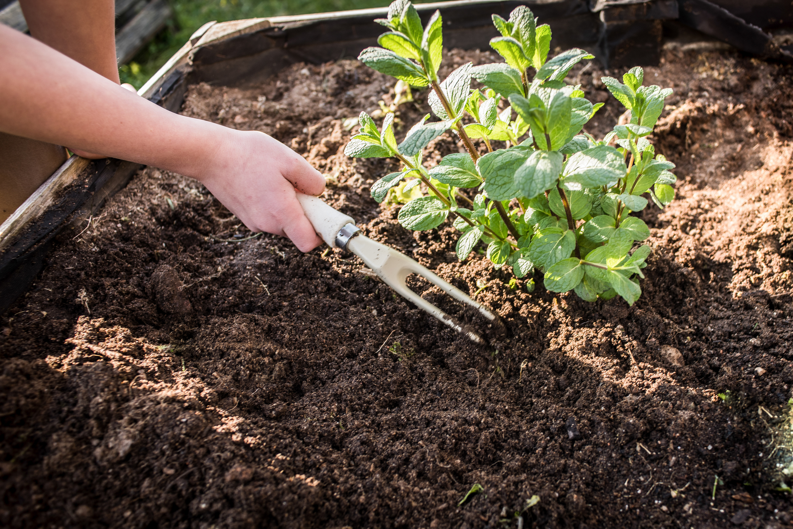
Phase 1
Project Proposal
Dataset
Tools and Techiques used
Plan of Action

Slide 5
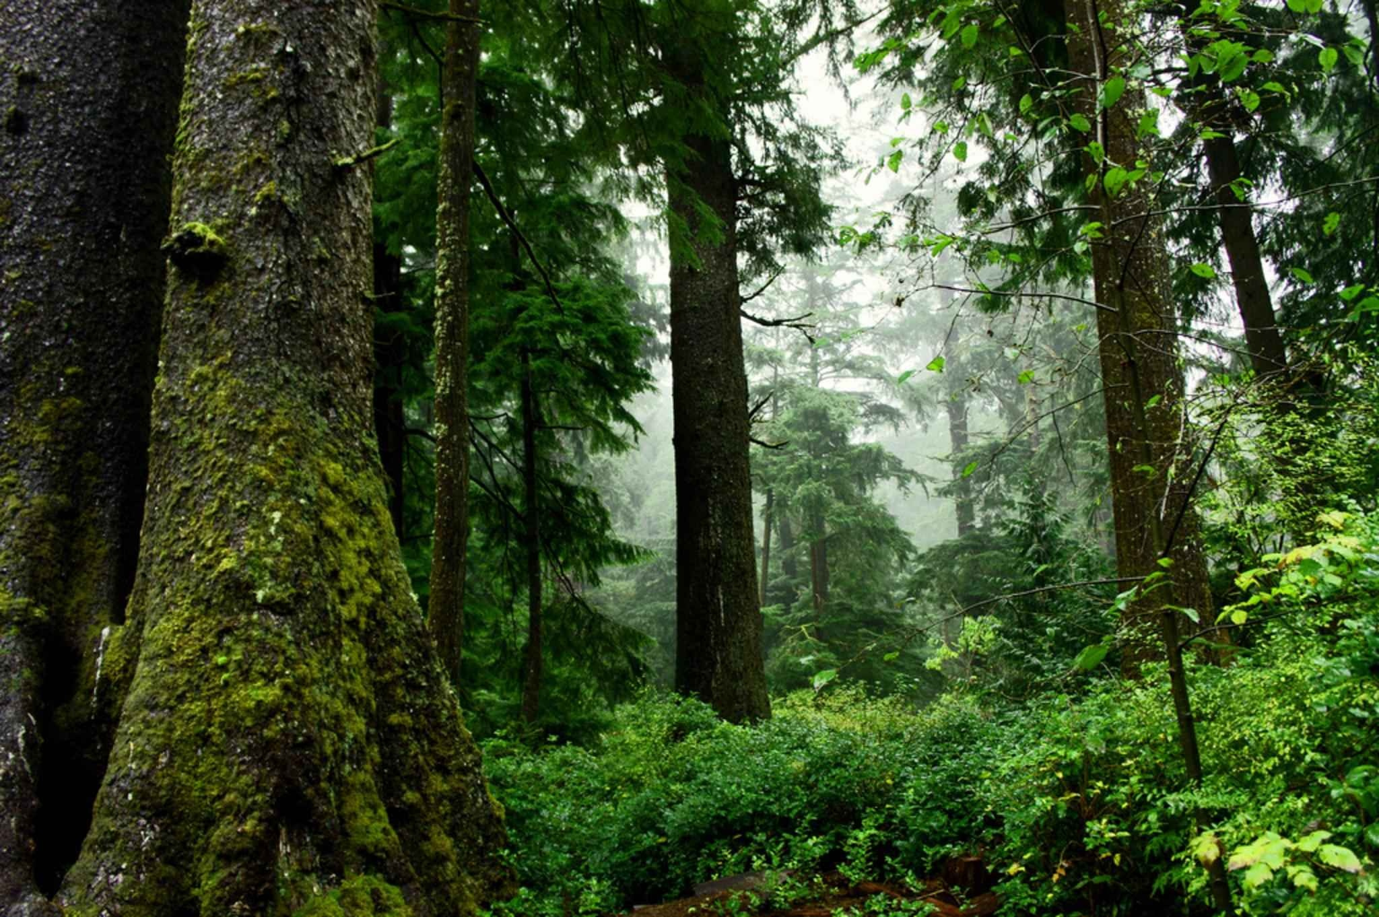
Phase 2
Initial Model Development
Data Preparation: Augmentation
Model Architecture: Creating CNN model
Training of the Model

Slide 6
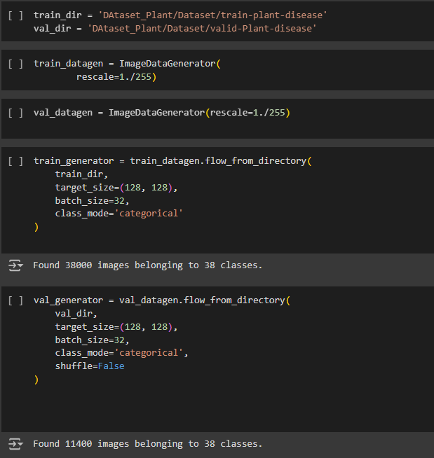
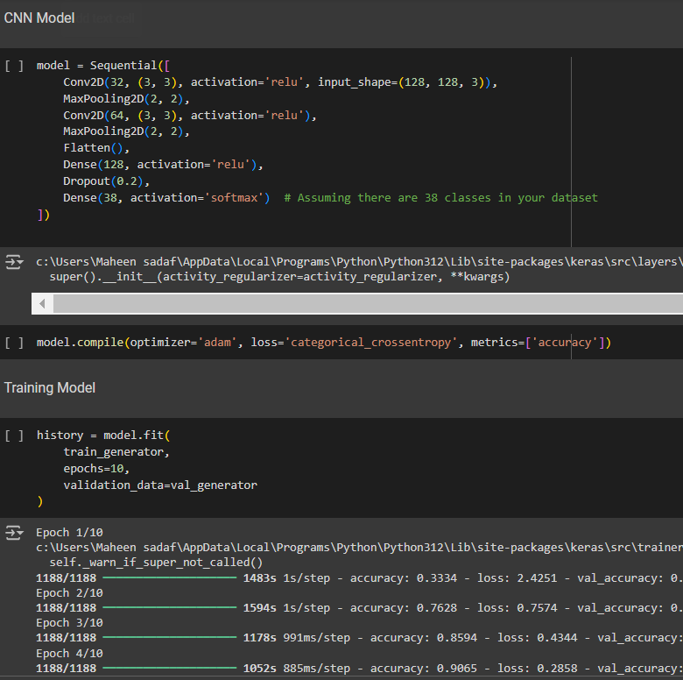
Code

Slide 7
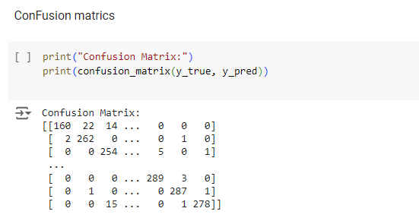
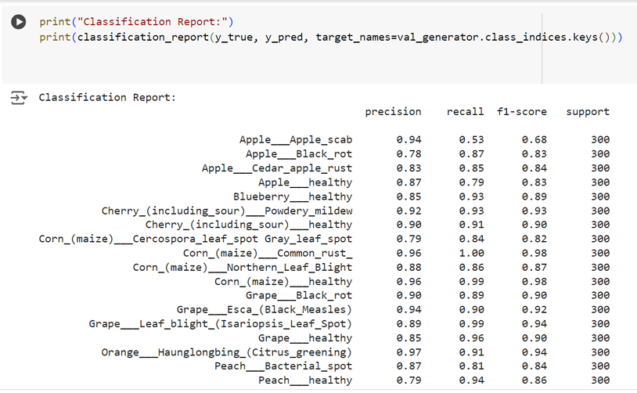
Results and Evaluation
Confusion Matrix
Classification Report

Slide 8
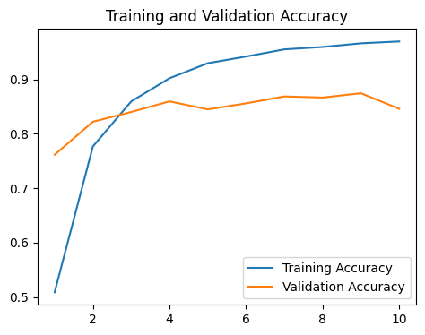
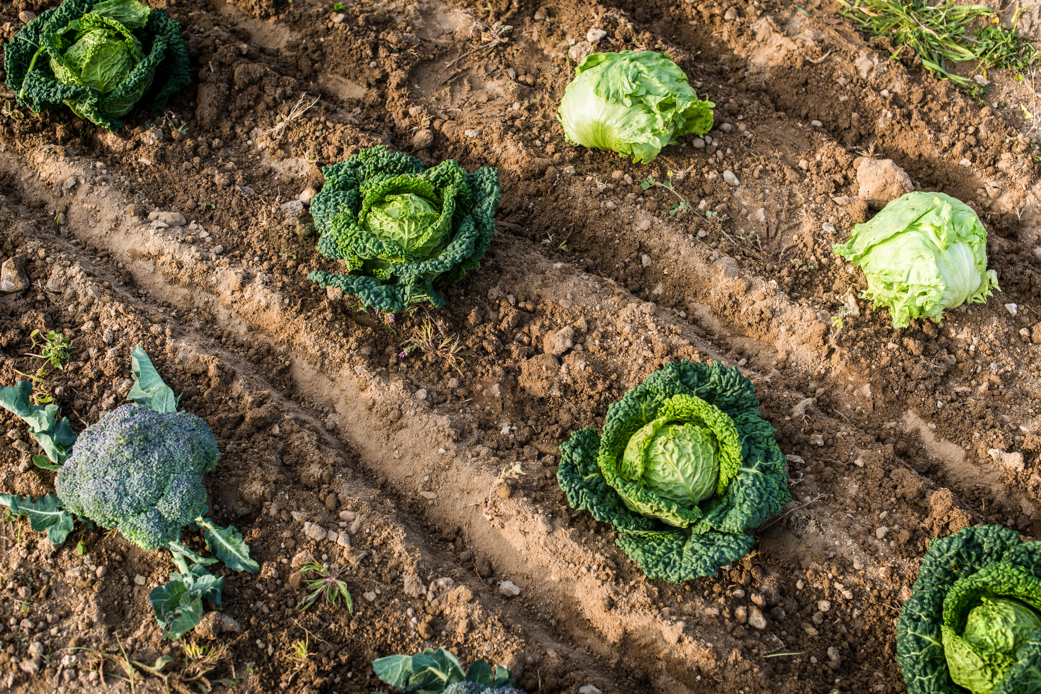
Training And Validation Accuracy Graph
Plot the training and validation accuracy over epochs

Slide 9
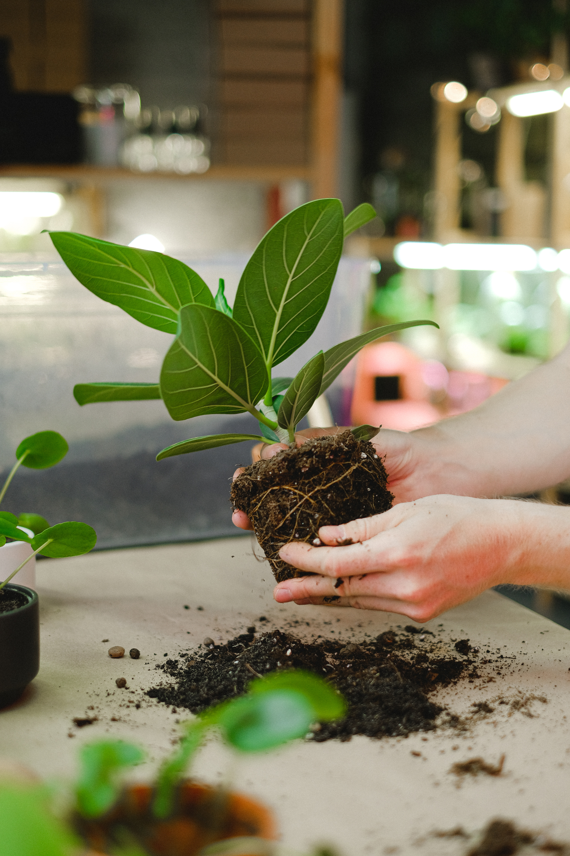
Phase 3
Tunningof the Model
Transfer Learning: Using InceptionV3 pre-trained model
Data Augmentation: Enhanced with shear, zoom, and flip
Fine-Tuning: Training the top layers and fine-tuning the entire model

Slide 10
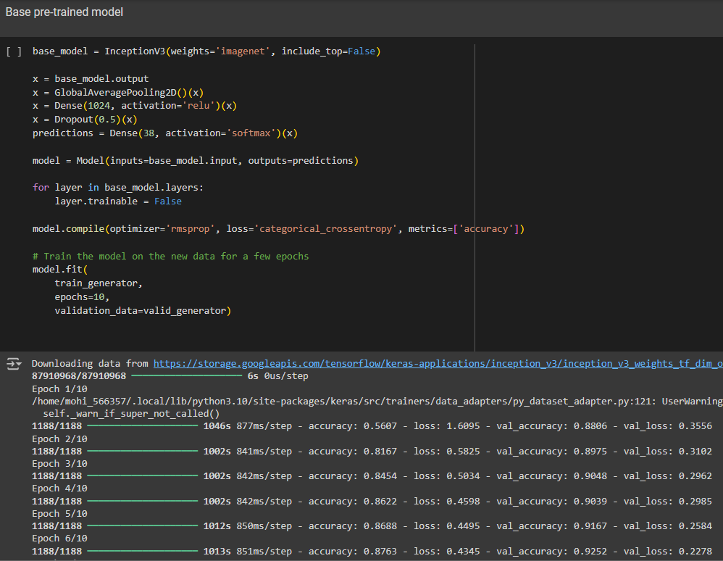
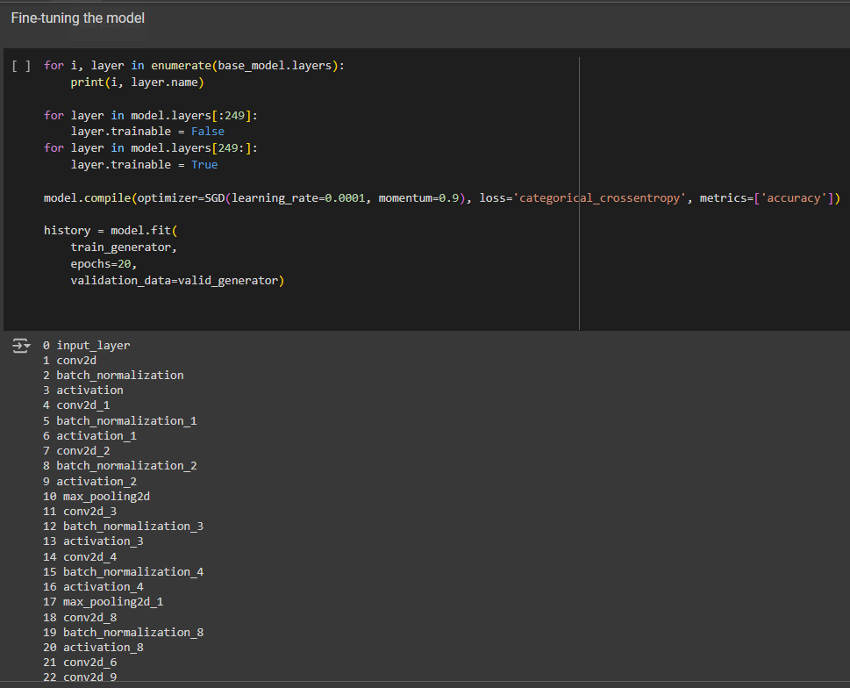
Code

Slide 11
Results and Evaluation
Confusion Matrix
Classification Report

Slide 12
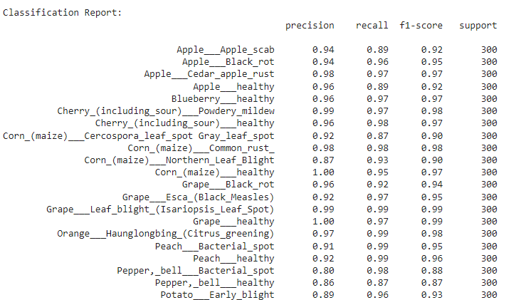
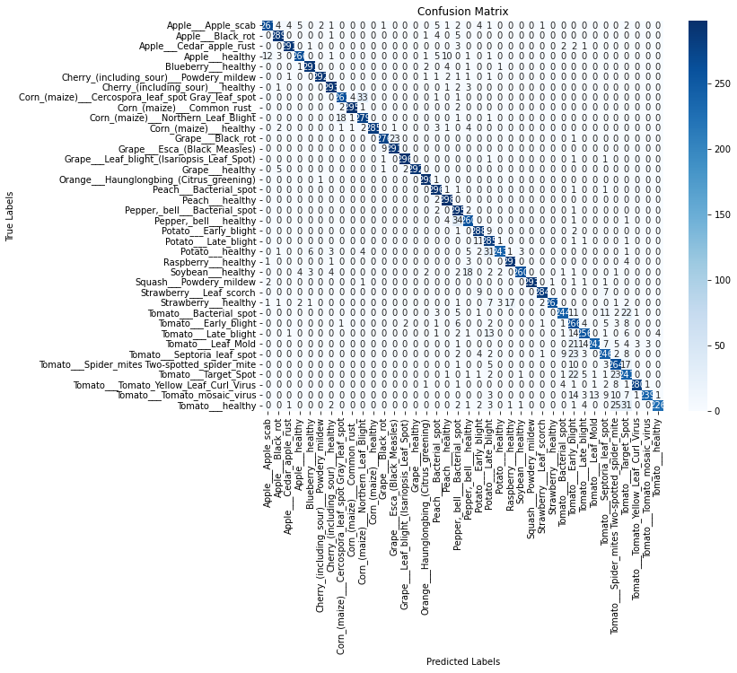
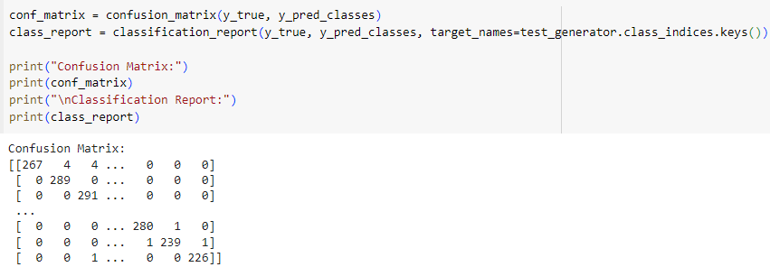
Result and Evaluation
Confusion Matrix
Classification Report

Slide 13
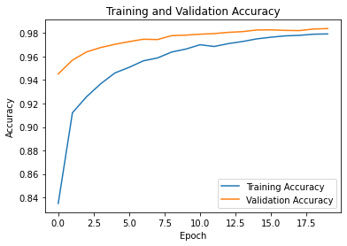
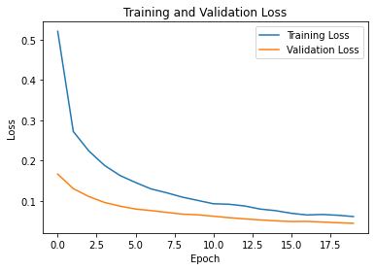
Training And Validation Accuracy & Loss Graph
Plot the training and validation accuracy over epochs
Plot the training and validation loss over epochs

Slide 14

Additional work
Front end of the Project
HTML for structure
CSS for styling
JavaScript for interactivity
Flask for serving the application

Slide 15
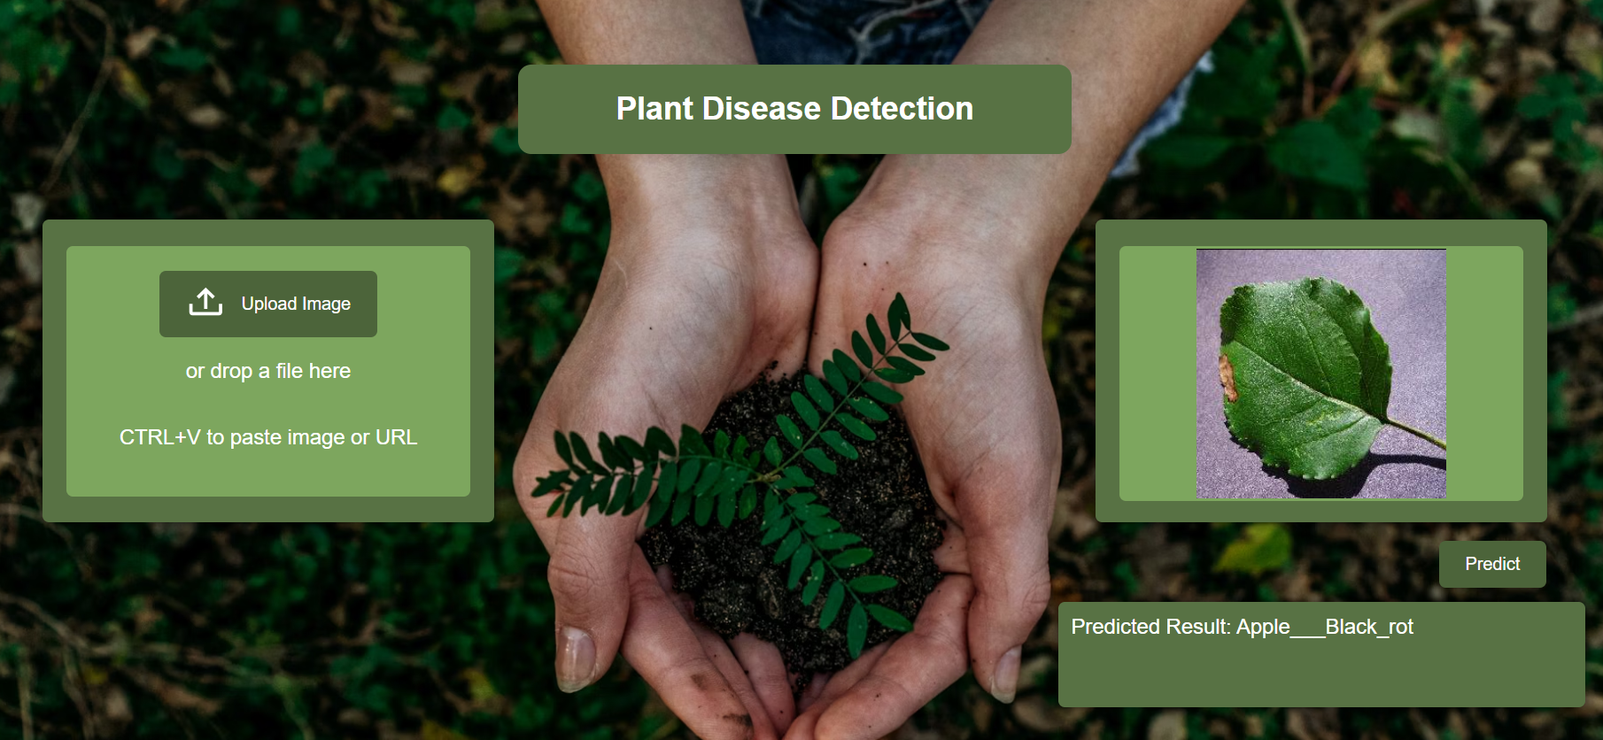

Slide 16

Conclusion
Summary of the project's achievements
Tips to Improve your model

Slide 17


